Slide 1
Program Design and Branching Structures

Slide 2
Introduction to Top-Down Design
Natural tendency to start programming without wasting time thinking about the problem.
Works for small tasks
Fails miserable for large ones
Programming is easy. It’s knowing what to program that’s hard.
Top-down design is the process where:
Start with the large task.
Break it down to more easily understood subtasks.
Code and test each subtask.
Integrate and test the total task.

Slide 3
Top-Down Design Steps
Clearly state the Problem.
Programs are written to fulfill a perceived need.
Develop a clear understanding of the problem that need to be solved.
A clear statement of the problem will prevent misunderstanding and helps the designer organize his or her thoughts.
Define the inputs and output required.
Design the algorithm.
Define the step-by-step procedure for finding the solution to the problem.
Break the problem down (decompose) into a series of subtasks where each subtask performs a simple clearly understandable job.
Refine each task until each step is clearly outline using pseudo-code.
Turn the algorithm into FORTRAN code.
If you have completed the decomposition and refinement process properly, this step will be very easy and straight forward.

Slide 4
Pseudo-Code and Flowcharts
Construct - used to describe the algorithm that you intend to implement.
Pseudo-code
A hybrid mix of FORTRAN and English
Structured like FORTRAN
Good for rapid the changes during preliminary development
Flowcharts
Describe the algorithm graphically
Not useful during preliminary stages of development.

Slide 5
Testing the Code
Testing goals:
Verify that it works for all legal input data sets.
Test all possible branches to confirm that the program operates correctly for all possible circumstances.
Unit testing: Test the individual components to verify that each performing as designed.
Build-up the program and test the interaction of the individual components.
The first complete build of the program is usually called an alpha release.
Exercised by the programmers and others close to the development to identify and remove any serious bugs
The Beta release is prepared and release to a limited number of friendly users for use in normal everyday use.
Errors are reported back to the developers

Slide 6
Top-Down Design Summary
Clearly state the problem.
Define the inputs require and the outputs to be produced.
Design the algorithm that you intend to implement in the program. Use pseudo-code or flow charts to outline program.
Turn the algorithm into FORTRAN Statements.
Test the resulting program.

Slide 7
Logical Constants, Variables and Operators
Most FORTAN branching structures are controlled by logical values

Slide 8
Logical Constants, Variables
Logical data type contains one of only two possible values:
.TRUE.
.FALSE.
(Note: the period surrounding the value is important.)
A Logical variable is a variable containing a value of the logical data type.
A logical variable is declared using the LOGICAL statement:
LOGICAL :: var1 [, var2, var3, …]

Slide 9
Logical Assignments and Calculations
Logical calculations are performed with an assignment statement
logical_variable_name = logical_expression
The expression to the right of the equal sign can be any combination of valid logical constants, variables, and operators.
A logical operator is an operator on numeric, character, or logical data that yields a logical result.

Slide 10
Logical Operators
There are two basic types of Logical operators
Relational operators
Combinational operators

Slide 11
Relational Operators
Operators with two numerical or character operands that yield a logical result.
Results depend on the relationship between the two operands.
The general form is:
a₁ op a₂
There are two forms of each relational operator.
Symbols – (introduced in FORTRAN 90)
Characters surrounded by periods – (Holdover from earlier versions of FORTRAN)
Evaluated after all arithmetic operations.
Comparing Data
When comparing integers and real numbers the integer is converted to a real before the comparison is performed.
Comparison of numerical and Character data is illegal.

Slide 12
Relational Logic Operators

Slide 13
Combinational Logical Operators
Operator with one or two logical operands that yield a logical result.
There are four binary operators: .AND., .OR., .EQV., and .NEQV.
And one unary operator: .NOT.
The general form is:
l₁ .op. l₂
Hierarchy of operations: Evaluated after all arithmetic operations and all relational operations have been evaluated.

Slide 14
Hierarchy of operations
All arithmetic operators are evaluated first in the order previously described.
All relational operators (==, /=, >, >=, <, <=) are evaluated working from left to right.
All .NOT. operators are evaluated
All .AND. operators are evaluated, working left to right.
All .OR. operators are evaluated, working from left to right.
All .EQV. and .NEQV. operators are evaluated, working from left to right.

Slide 15
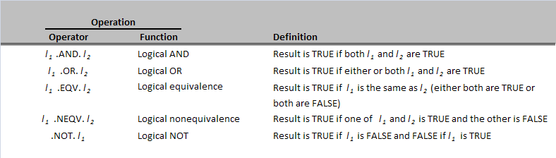
Combinational Logical Operators
Again, the period surrounding the characters is important.

Slide 16
Logical Values in Input and Output Statements
If a logical variable appears in a list-directed READ statement
Corresponding value must be a character or group of characters beginning with either:
T for .TRUE. or
F for .FALSE.
If a logical variable appears in a list-directed WRITE statement
The output will be either a single character:
T for .TRUE or
F for .FALSE

Slide 17
Control Constructs: Branches
FORTRAN statements that select and execute specific sections of code will skipping other sections.
Two variations:
IF Construct
SELECT CASE Construct

Slide 18
The Block IF Construct
Specifies that a block of code will be executed if and only if a certain logical expression is true.

Slide 19
IF Block Construct
[name: ] IF (logical_expr_1) THEN
Statement 1
Statement 2
…
ELSE IF (logical_expr_2) THEN [name]
Statement 1
Statement 2
…
ELSE [name]
Statement 1
Statement 2
….
END IF [name]
Specifies that a block of code be executed if and only if a certain logical expression is TRUE.
ELSE IF and ELSE clauses allows alternate sections of code to be executed if preceding logical statements are FALSE.
IF blocks may be nested. Two blocks are said to be nested if one lies entirely within a single code block.
IF blocks can not overlap.
IF blocks can be named.
Name must begin with a letter
Name can be up to 31 alphanumeric characters
Helps the programmers and the compiler keep the IF block straight.
Example:

Slide 20
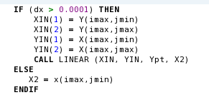
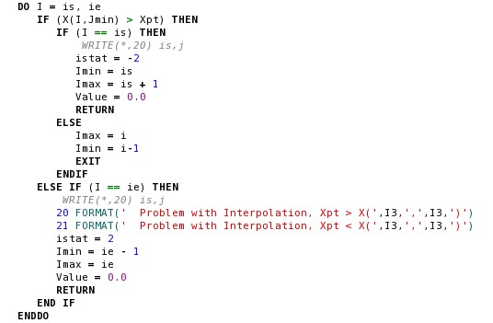
IF Block Construct Example

Slide 21
The Logical IF Statement
An alternative form of the block IF is a single statement:
This form of the logical IF is equivalent to a block IF construct with only one statement.
IF ( logical_expr ) Statement

Slide 22
The SELECT CASE Construct
Permits the programmer to select a particular code block to execute based on the value of a single integer, character, or logical expression

Slide 23
The SELECT CASE Construct
General Form:
Case “name”
Unique within program
Must be on:
SELECT CASE statement
END SELECT statement
Optional on:
CASE statement
CASE DEFAULT
Optional
Only executes if case_expr is outside of the values of all case_selectors
Example:
[name:] SELECT CASE (case_expr)
CASE (case_selector1) [name]
Statement 1
Statement 2
…
CASE (case_selector2) [name]
Statement 1
Statement 2
…
….
CASE DEFAULT [name]
Statement 1
Statement 2
…
END SELECT [name]

Slide 24
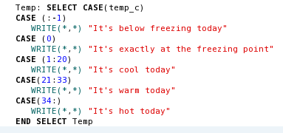
SELECT CASE Example

Slide 25
Case Selection
Case-selector can take on one of four values:
(Case-value) Execute block if case-value == case_expr
(Low-value: ) Execute block if low-value <= case_expr
(:High-value ) Execute block if case_expr <= high-value
(low-value : high-value) Execute block if
low-value <= case_expr <= high-value

Slide 26
Good Programming Practice
Always indent code block IF and CASE constructs to make them more readable.
Be cautious about testing for equality with real variables in an IF construct, since round-off errors may cause two variables that should be equal to fail a test. Instead, test to see if the variables are nearly equal within the round-off error expected.
Always include a DEFAULT CASE clause in your case constructs to trap any logical errors or illegal inputs that might occur.

